Slide 1
Sensex logs Data Processing-POC

Slide 2
SCOPE
Load unprocessed data in the form of xls from
LFS to HDFS
To retrieve processed data from input(unprocessed data)
by using hadoop components like MR and PIG.
Processed data will be stored in Mysql and Hive External
tables
POC has to be build by using following component
Map Reduce
Pig
Hive
Hbase
Sqoop

Slide 3
Requirement
Input File is in xls format
Input: SENSEX LOGPROCESS_USERSTORY_INPUT DATA. xlsx
Input Data Format:
SENSEX_ID SENSEX_NAME TYPEOF_TRADING LOCATION OPENING_BALANCE CLOSING_BALANCE FLUTUATION_RATE

Slide 4
Sample Input Data
121214 NSC_Sensex _report SIP California 26252 27000 15
121215 NSC_Sensex _report ShortTerm NewYork 5500 6000 12
121216 NSC_Sensex _report SIP NewDelhi 5252 65000 25
121217 NSC_Sensex _report ShortTerm California 17000 18500 27
121218 NSC_Sensex _report ShortTerm NewYork 4500 5500 22
121219 LSA_Sensex_report Daily Hyderabad 25432 28645 5
121220 LSA_Sensex_report SIP California 25000 26000 25
121221 LSA_Sensex_report SIP California 45000 49356 36
121222 LSA_Sensex_report SIP NewYork 8965 9654 45
121223 LSA_Sensex_report SIP Hyderabad 3654 5000 46

Slide 5
Requirement Contd..
Copy Input data into HDFS
Develop a Map Reduce Use Case to get the below filtered results
From the HDFS Input data(Excel data)
If Type of trading is ‘SIP’
→Openbal>25000 & Fluctrate>10
store “HighDemandMarket”
→Closebal<22000 & Fluctrate in b/w 20-30
store “OngoingMarketStrategy”
If Type of trading is ‘ShortTerm’
→ Openbal<5000
store “Wealthy Products”
→Location “NewYork OR California”
store “Reliable Products”
Else
store in “Other Products”

Slide 6
Requirement Contd..
Develop a PIG Script to filter the Map Reduce Output in the below fashion
Group the Data based on location
Get Top 400 Records from each location based on Fluctuation Rate
EXPORT the same PIG Output from HDFS to MySQL using SQOOP
Write the same PIG output into HBase Table for Low latency query access.
Store the same PIG Output in a HIVE External Table with PARTITIONING enabled(with Type Of Trading)

Slide 7
Architecture Flow
INPUT(LFS)
HDFS
MAP REDUCE
PIG
MYSQL
HBASE
HIVE
SQOOP

Slide 8
Architecture Design Flow
Copy to hdfs
Unprocessed data
LFS
HDFS
MAP REDUCE
Semi Processed data from MR
Use Semiprocessed data
PIG
HDFS
H
Processed data
HDFS
Export to
HIVE
SQOOP
HBASE
MYSQL

Slide 9
Complete Flow Of POC
HDFS:
Input data (.xls format) need to be loaded in HDFS()
Syntax:
hdfs dfs –put Input /Directoryname
MAP REDUCE:
To analyze the data and to retrieve the data out
of it by using Map Reduce (.sh)
Syntax:
hadoop jar <<runnablejar>> <<driverclassname>> <<inputpath>> <<outputpath>>

Slide 10
Steps used in Map Reduce
CUSTOM INPUT FORMAT
CUSTOM RECORD READER
(Parsing)
DRIVER CLASS
CUSTOM MAPPER CLASS

Slide 11
Complete Flow of POC Contd..
PIG Processing
To eliminate duplicate values (if any) from Map Reduce Output and to sort the data based on location using PIG Component(Sensex_Script2.pig)
Transformations used: load,group,order by,limit, flatten
Syntax:
Inidata = LOAD '$InputPathSensexdata1' Using PigStorage('\t') as ($Input_Schema_Sensex_Format);
groupdata = GROUP inidata BY LOCATION;
result = foreach groupdata {orderdata= ORDER inidata BY FLUTUATION_RATE DESC; limitdata=LIMIT orderdata 400;GENERATE group,FLATTEN(limitdata);};
STORE result into 'Pigoutput_sensexdata_400';

Slide 12
Complete Flow of POC Contd..
SQOOP Exporting to Mysql
Exporting the processed PIG Output to Mysql using SQOOP(.sh)
Syntax:
sqoop export --connect jdbc:mysql://localhost:3306/poc_sensex --username root --password root --table sensex_highdemandmrkt --export-dir /poc-output/HighDemandMarket-final/part-r-00000 --input-fields-terminated-by '\t'

Slide 13
Complete Flow of POC Contd..
HIVE External Tables
Same PIG Output, loading into Hive External tables(.sh)
Syntax:
Creating external table:
CREATE EXTERNAL TABLE SENSEX_RECORDS(SENSEXID INT, SENSEX_NAME STRING,LOCATION STRING, OPENING_BAL INT, CLOSING_BAL INT, FLUCTUATION_RATE INT)
PARTITIONED BY (TYPEOF_TRADING STRING)
ROW FORMATTED DELIMITED
FIELDS TERMINATED BY ','
LINES TERMINATED BY '\n'
STORED INTO LOCATION '/USER/HIVE/WAREHOUSE/USECASE1';
Loading data into external tables LOAD DATA INPATH 'home/hdfsuser/pig_output/Sensex*.*'INTO TABLE SENSEX_RECORDS;

Slide 14
Hbase
To create namespace and table in h-base and Load data into
create_namespace 'Sensex_db4'
create 'Sensex_db4:sensextab','Sensex'
Quit
BulkLoad Command
hbase org.apache.hadoop.hbase.mapreduce.ImportTsv -Dimporttsv.columns=HBASE_ROW_KEY,CF1:sensexname,CF1:TOT,CF1:loc,CF1:OB,CF1:CB,CF1:FR Sensex_namespace:Sensex_record hdfs://localhost:8020/$pig_out/

Slide 15
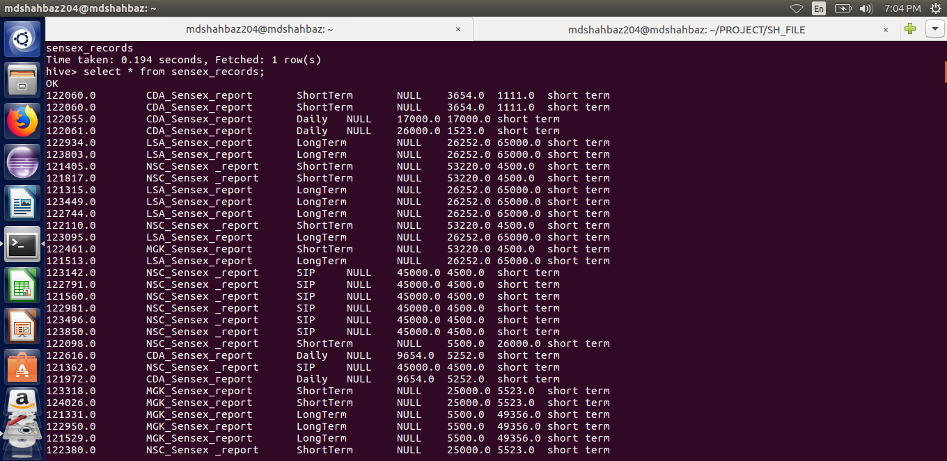
Hive Tables Output

Slide 16
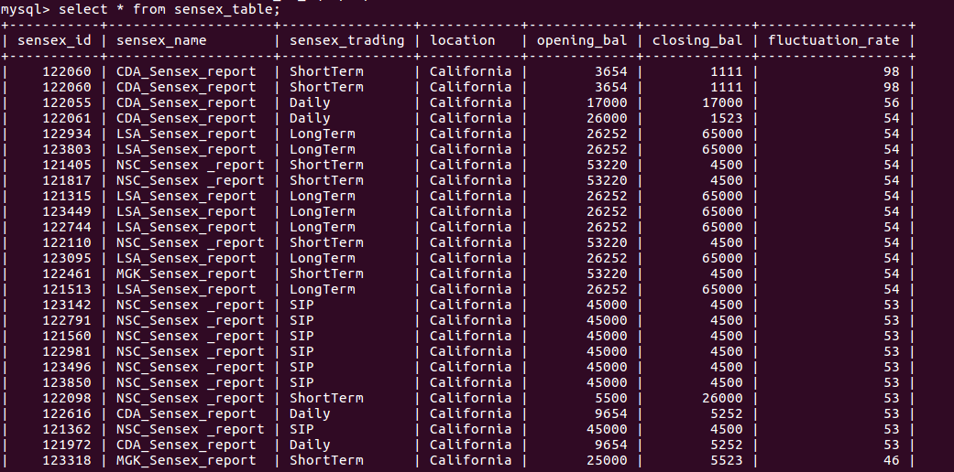
Mysql Output

Slide 17
THANK YOU

